Slide 1

General Education Council
Assessment presented to
CU College Leadership Teams
December 7, 2023

Slide 2
Agenda
Introduction
Discuss role and structure of the General Education Council
Review materials and resources
Review the assessment cycle

Slide 3
General Education Council
GEC Purpose: The GEC oversees General Education at Commonwealth University, which includes coordination and assessment of the program.
The responsibilities of the Council also include:
  initiating, reviewing, and recommending policy changes regarding General Education;
  reviewing and recommending General Education curriculum; and,
  coordinating mentoring and assessment efforts with departments involved in supporting General Education program goals and student learning objectives.

Slide 4
General Education Council
GEC membership:
Adrianne McEvoy (MA – History, Political Science, & Philosophy, CASSH; term: 2022-2024), Chair
Kim Batty (LH- Sport Mgmt, ZCOB; term: 2023-2026)
Atika Bennadi (MA – Economics & Finance, ZCOB; term: 2023-2026)
Jeff Bosworth (MA - History, Philosophy, & Political Science; term: 2023-24 Sabbatical replacement)
Jennifer Demchak (MA – Environmental, Geographical, and Geological Sciences, COST; term: 2022-2025)
Teri Doerksen (MA – English, CASSH; term: 2022-2025 – on Sabbatical)
Heather Erb (LH – History, Philosophy, & Political Science, CASSH; term: 2022-2025)
Jamie Foor (LH – Psychology, CASSH; term: 2022-2025)
Steven Granich (LH – Social Work, COEHS; term: 2022-2024)
Luke Haile (BL - Health & Exercise Science, COHP; term: 2022-2024)
Mykola Polyuha (BL - Languages & Cultures, CASSH; term: 2022-2025)
Loren F. Selznick (BL - Accounting & Business Law, ZCOB; term: 2023-2026)
Rebecca Willoughby (BL - Student Success, Non-Aligned; term: 2022-2025)

Slide 5
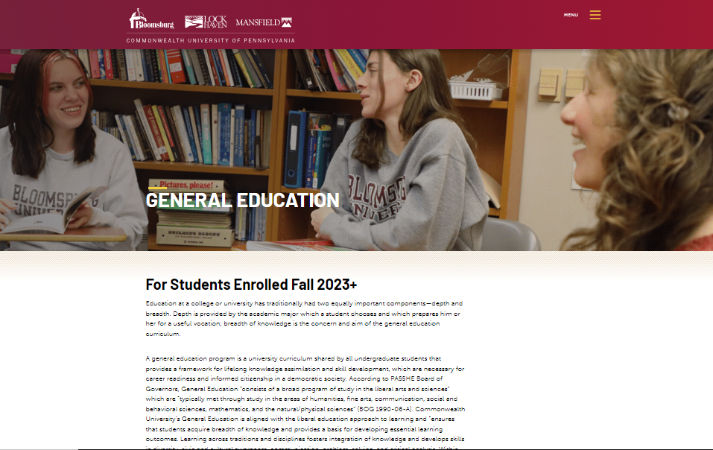
GE Materials and Resources
CU General Education Council SharePoint Site
CU General Education Web Page
  GE Curriculum Map
  GE Advisor and Student Handbook (in draft)
  GE Rubrics
  GE Course Data Worksheet (in draft)
  GE Data Collection Survey (Qualtrics)
  GE Themes, Goals, Objectives, Rubrics, and Courses
  Information on legacy programs

Slide 6
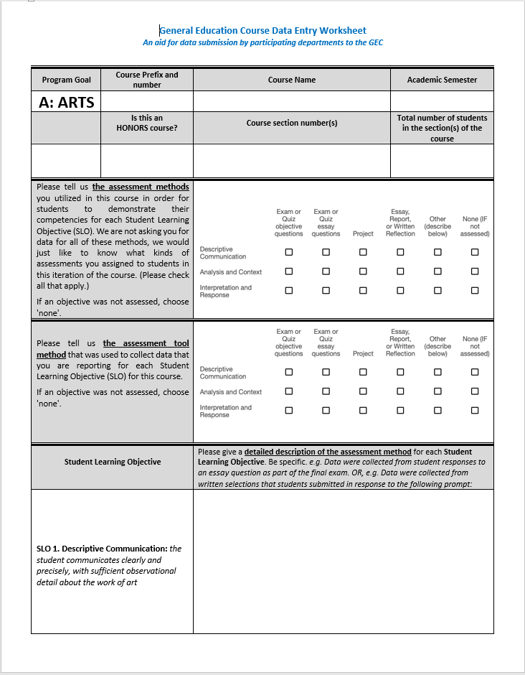
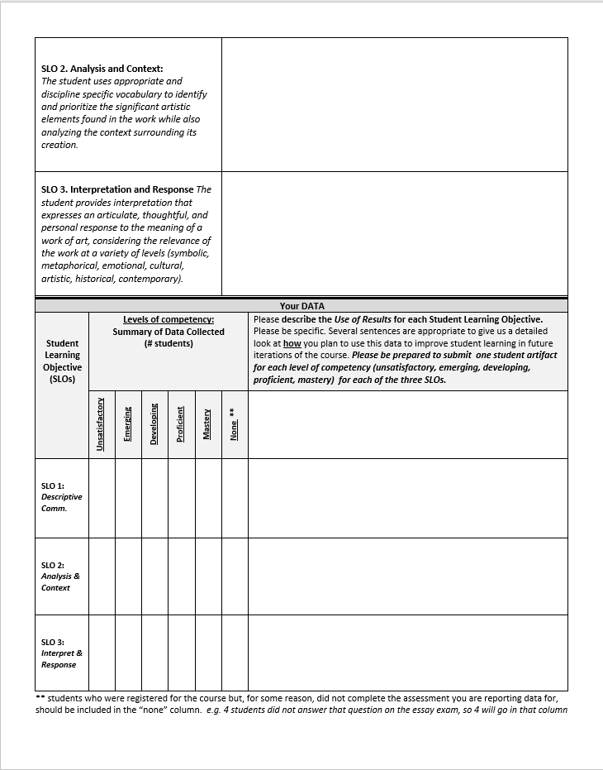
GE Course Data Worksheet
Use to prepare data submission
  Basic course information
  Assessment methods used to:
    Demonstrate competencies for SLOs
    Collect the data reported for SLOs (both checkoff and narrative)
  Outcomes data
    Report raw data at each competency level
    Describe how you will use data
    Submit one student artifact for each competency level and assessment instrument
  Submit data into GE Data Collection Form

Slide 7
GE Assessment Cycle
Data collection and summary for all program goals and SLOs will occur each semester for the CU GE Curriculum
Assessment Review (deeper dive) will occur on a four-year rotation
  Year 1: FA23: FYS (1 course;1 prefix) and Writing (2 courses; 1 prefix)
  SP24: Oral Communication (6 courses; 3 prefixes) and Quantitative Reasoning (15 courses; 3 prefixes)
  Year 2: FA24: Historical Themes (29 courses; 11 prefixes) and Diversity (35 courses; 22 prefixes
  SP25: Global Perspectives (50 courses; 25 prefixes) and Foreign Language (9 courses; 9 prefixes)
  Year 3: FA25: Citizenship and Society (20 courses; 11 prefixes) and Ethical Reasoning (7 courses; 3 prefixes) and Critical Analysis and Reasoning 35 courses; 14 prefixes)
  SP26: Natural World (48 courses; 12 prefixes) and Technology (16 courses; 14 prefixes)
  Year 4: FA26: Literature (30 courses; 11 prefixes) and Arts (20 courses; 9 prefixes) and Creative (62 courses; 9 prefixes)
  SP27: Write 7-semester Assessment report
Limited set of program goals will be used for legacy GE assessment
  2023 – 2024, Written Communication
  2024 – 2025, Oral Communication
  2025 – 2026, Quantitative Reasoning
  2026 – 2027, Global Perspectives
  2027 – 2028, Natural Sciences
Trainings are slated for end of semester / beginning of next semester

Slide 8
Questions

