Slide 1

Administrative Unit – Nuventive Mentoring Session
April 30, 2024

Slide 2
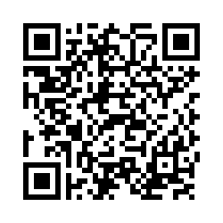
Agenda
Welcome and introductions
Review annual report submission timeline and process
Review OIE web pages
Discuss official v. operational data
Review institutional and program data (?) dashboards
Review Nuventive Solutions Premier (esp. changes since 11-28-23) and best practices
Ask questions and give answers (throughout the entire session)
Complete session evaluation

Slide 3
Administrative Unit Annual Report Timeline and Process
Annual Report Due Dates
  May 15, 2024 – faculty-led units submit
  June 14, 2024 – administrative units submit
  June 30, 2024 or when available – fiscal affairs and advancement fiscal year-end data submitted
  Note: Use placeholders to denote outcomes data not available at the time of submission. Report data as soon as available (e.g., audited financials, census data enrollment and retention)
Submitted fully in Nuventive Solutions Premier
Use information and materials for 2023-24 on OIE-Sponsored Technology web page

Slide 4
Review OIE – Assessment Web Pages
The following web pages provide information on assessment-related topics / resources:
Strategic Planning (for the strategic plan and KPIs)
Institutional Effectiveness (OIE) (for general resources)
Assessment – (for assessment committee structure – roles)
Program Assessment (for academic program assessment resources and dashboards)
OIE-Sponsored Technology (for Lightcast, Qualtrics, and Nuventive)
Surveys (for First Destination, Climate, and NSSE surveys)
Institutional Research (for institutional data dashboards)

Slide 5
Official v. Operational Data (MIKE)
Official reporting
Data that Institutional Research captures as of official reporting dates (e.g., census date) that should be used for reporting to accreditors and other “official” reporting shared with outside entities. These data would also be used for academic program annual reports and reviews.
Provided by IR, primarily through dashboards or ad hoc requests
Operational reporting
Reports from the live student information system, Banner, to help support day-to-day operations. They may include current student lists, course enrollments, list of those who have applied to graduate, etc.
Provided through existing Argos reports, IT Help Desk, or the Registrar

Slide 6
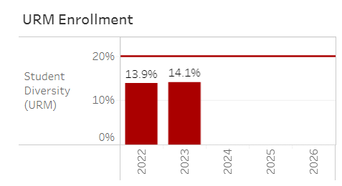
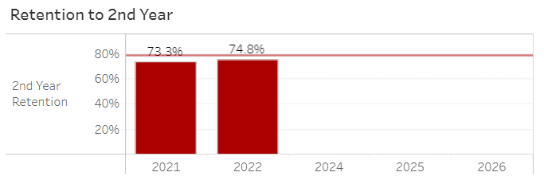
Dashboards Dashboard
KPI and Selected Metrics Dashboard
IR Dashboards
Program Assessment Dashboards
6

Slide 7
Expectations for Assessment Reporting
May want to run the Plan Progress Report and use it as a basis to collect/organize your data (see sample Student Success Plan Progress Report)
Review goals, initiatives, measures, and targets
    What did you say you would do and measure?
    What did you do and measure?
    Are there some adjustments that should be made (e.g., do your measures and targets align with each other and your goals)
    Consult your supervisor and make needed adjustments in Nuventive Improve
Enter results and conclusion (met/not met) for all measures by June 14/17 or as soon as data become available
Indicate action plan based on results and operational needs
Upload/relate documents that provide evidence of results/outcomes

Slide 8

Reporting in Nuventive Solutions Premier
Log into Nuventive
Review basic screens
Discuss changes/additions to the platform since the January session
Highlight best practices as it relates to each screen
Ask questions
Complete session evaluation and provide feedback

Slide 9
Questions

