Slide 1


Enterprise Vehicle Rental and Travel Information Overview
Additional information is located on the Accounts Payable Travel Page:
https://www.commonwealthu.edu/offices-directory/financial-services/travel-management
*to make a rental reservation, you must access the Enterprise website from the AP Travel page*

Slide 2
Enterprise-Rent-A-Car Benefits
  New model vehicles = less risk (safety) and satisfied customers;
  Flexible delivery- campus delivery or any nearby Enterprise branch;
  On-line reservations;
  Full collision damage waiver with no deductible;
  Primary third party liability protection up to $1 million in coverage;
  Vehicles available to switch out or change at over 7,000 locations across the United States with 24/7 access to additional roadside assistance;
  Frequent users have the option of ePlus enrollment;
  One monthly invoice to the university;
  Used system-wide

Slide 3
Who can drive a University Owned or Enterprise rental vehicle?
University-owned or Enterprise vehicles are operated for University-related purposes by designated individuals acting within the scope of their employment. The following requirements must be met in order to operate these vehicles:
    Possess a valid license
    Employed by Commonwealth University (including student employees)
    Operating the vehicles are pursuant to their employment responsibilities
    Must be 21 years old to rent a car
    Must be 25 years old rent the 12 or 15 passenger vans

Slide 4
Traveling with a Rental Vehicle
Submit a Travel Approval Request (TAR)
  TAR must be approved PRIOR to reserving a rental car
  Use the Mileage Calculator found on the Enterprise website to determine the most economical option of either renting a vehicle or using your personal vehicle
Once TAR approved, access the Enterprise website from the AP Travel webpage to make your rental reservations
  Include your Trip number from your TAR on the Enterprise reservation
After trip completed, submit Travel Expense Report
  When entering receipts, enter your rental as “X: Paid to Vendor-Car Rental” and amount from Enterprise invoice

Slide 5
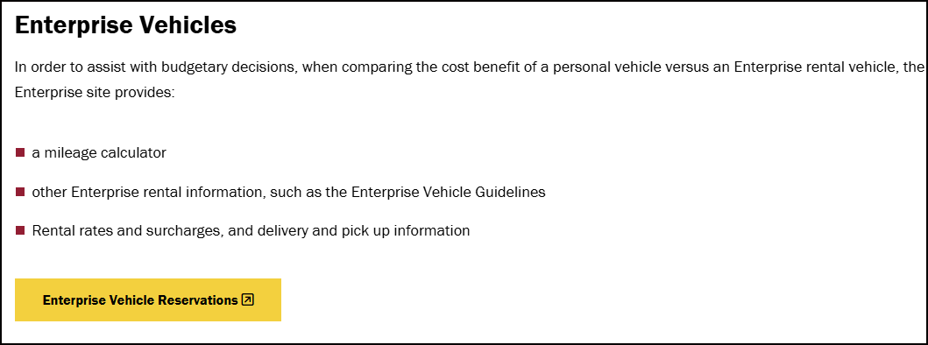
Log-In to the Enterprise Website from the Accounts Payable Travel Page
https://www.commonwealthu.edu/offices-directory/financial-services/travel-management
Click “Enterprise Vehicle Reservations”

Slide 6

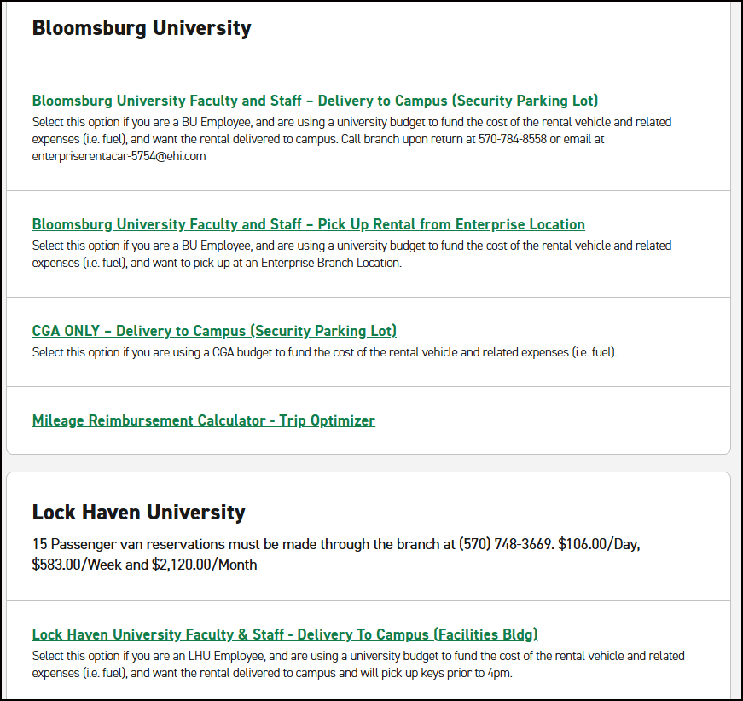
Making Reservations with Enterprise
Find the section specific to your campus

Slide 7
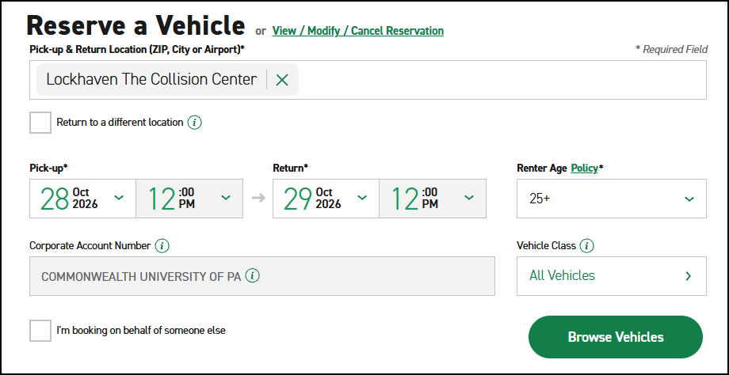
Making Reservations with Enterprise
After finding your campus section, select which option you need – the rental to be delivered to campus, pick up rental at Enterprise location, etc. and you will be routed to the Enterprise website.
Follow the step-by-step directions on the Enterprise-Rent-A-Car website
Enter your travel dates and click “Browse Vehicles”

Slide 8
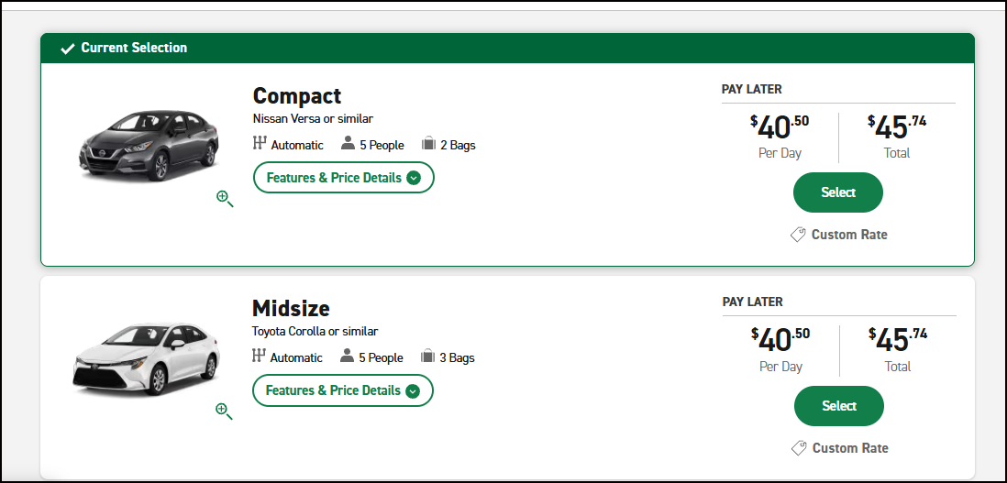
Making Reservations with Enterprise
Select “Compact” or “Midsize”Car for the most economical option.
Continue through the Enterprise pages. (Do not add extras like “Sirius XM” or “GPS”)

Slide 9
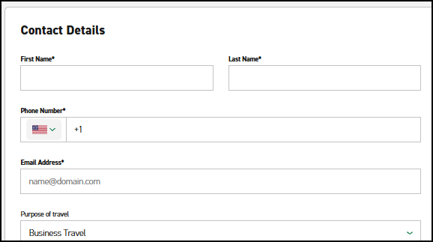
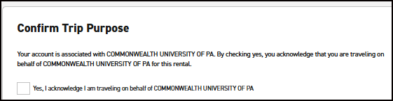
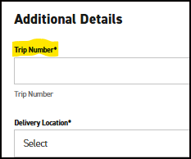
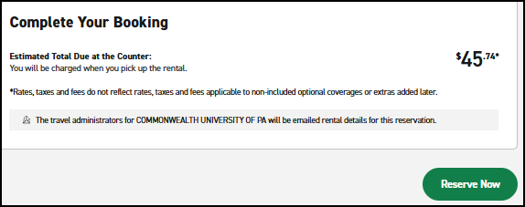
Making Reservations with Enterprise
Enter your contact details – name, phone number, and email
Confirm your trip purpose
Enter the Trip Number from your TAR under Additional Details
Click the green “Reserve Now” button

Slide 10
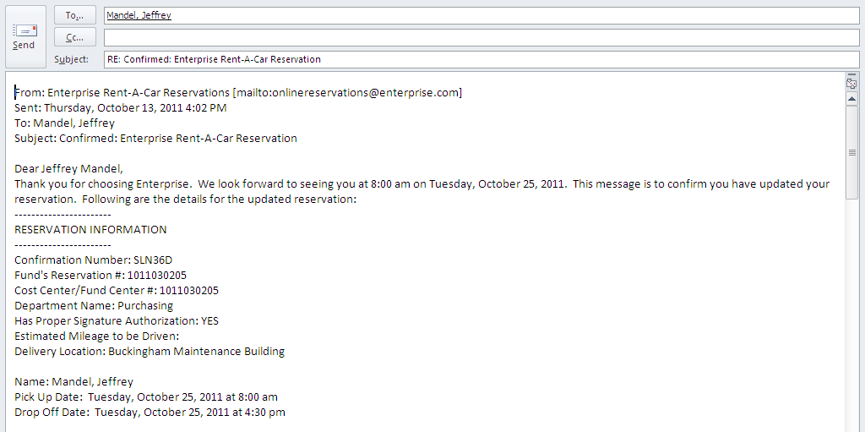
Confirmation Email
Once you have booked your reservation, you will receive an email from Enterprise:
*While tax may show on email, CU is tax exempt and applicable taxes will be removed*

Slide 11
Enterprise Vehicle Pickup and Drop-Off
Bloomsburg Campus: The Enterprise location is the faculty/staff red parking lot #4, adjacent to and west of the Andruss Building. When entering the lot, the first two spaces on the immediate right will be signed for rental car parking, and the key drop box is next to the first parking space. All rental car keys for pick up will be delivered to the University Police. The police staff will verify that the correct person is receiving the car keys and contract by checking the person’s picture identification card against the contract name.
Lock Haven Campus: The Enterprise rental vehicle drop-off site is currently at the Facilities Building. Enterprise parks the vehicle and brings keys inside to be picked up by employee. Employee returns vehicle to Facilities and drops the key off in the Enterprise key return box that is outside. If the employee needs to pick up the rental car outside of the hours of 7-3, please contact Tara Koch so arrangements can be made for the vehicle drop off/return to be moved to the University Police station.
Mansfield Campus: The Enterprise rental vehicles are dropped off at the Brooks Maintenance Building. Enterprise will park the vehicle and drop the key in the key box. The employee will need to get the key from Rich Priset. If the employee needs to pick up the rental outside of the hours of 7-3, please contact University Police so they can access the key lock box for the rental car.

Slide 12
Rental Vehicle Notes:
Keep a copy of the rental contract agreement with you during use of the vehicle. Works as the vehicle registration, proof of insurance, and provides important emergency contact information.
Fuel:
Renters should return Enterprise vehicles with the same level of fuel as when the rental was picked up.
  Renters do not have to fill the gas tank when you return the vehicle.
  Enterprise will charge a fee per gallon (approximately $2.00/gal) if they need to add gas to the rental car up to the level noted on the rental contract agreement.
If you need to purchase gas during your trip, make sure to obtain a receipt and include the expense on the Travel Expense Report.
  Initial and date the receipt(s) and attach to the TER.

Slide 13
Additional Notes:
Charges:
Charges for your rental vehicle by Enterprise Rent-A-Car begin on the date and time specified on the reservation. A one-day rental = 24 hours
  Example: If the reservation begins at 12 noon on Monday, it is due back by 12 noon on Tuesday.
Attach your Enterprise invoice to your Travel Expense Report. Payment for your rental will be directly charged to your funds center by Accounts Payable.
  In the receipts section of your TER, enter your rental charge under “X: Paid to Vendor-Car Rental”
Per our agreement with Enterprise, each rental has Damage Waiver Protection and Roadside Protection.
  Details on these can be found under the “Add Optional Extras” section when reserving your vehicle

Slide 14
Additional Notes:
Cancellation:
24 hour notice required for rental vehicle cancellation, otherwise a one-day rental fee will be applied. The renter must call their local Enterprise Branch to cancel the reservation if the vehicle is being delivered to campus.
  BL Branch: 570-784-8558
  LH Branch: 570-748-3669
  MA Branch: 570-513-0600
The $10.00 daily weekend fee will apply for cancellations of a Saturday, Sunday, or early Monday morning reservation if the rental vehicle has already been delivered to campus.

Slide 15
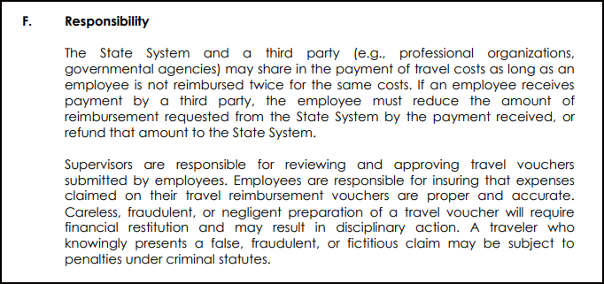
BOG Policy 1986-07-A:
Travel Expense Regulations
  https://www.passhe.edu/policies/documents/BOG_Policies/Policy%201986-07-A.pdf

