Slide 1
Guide to uploading clearances
COLLEGE OF EDUCATION AND HUMAN STUDIES

Slide 2
INTRODUCTION
The College of Education requires students to have updated clearances for all field experiences.
List of required clearances, websites and other important information can be found on the COE website https://clearances.commonwealthu.edu/.
It is the student’s responsibility to make sure clearances are updated within the timeframes set forth.
This process will allow you to:
  Upload/Update clearances for approval at any time
  Have access to your clearances at any time
You will receive an email if a clearance is rejected for any reason.

Slide 3
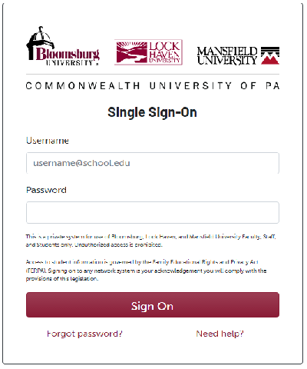
Log in
This is the website link you will use to log into your
account. This is a good site to bookmark. https://clearances.commonwealthu.edu/
You may upload your clearances from any
computer, in any location. If you experience
difficulty, please email Beth McClure at
bmcclure@commonwealth.edu.
This is what your login screen will look like.
Please use the same login you use
for your email.

Slide 4
Starting the process
Have your clearances ready to upload. You can submit in PDF, jpg or even a word document.
Log into the database at https://clearances.commonwealthu.edu/.

Slide 5
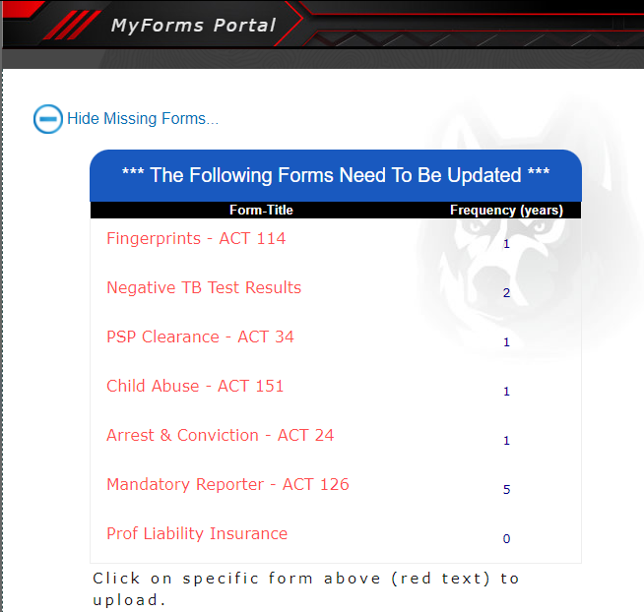
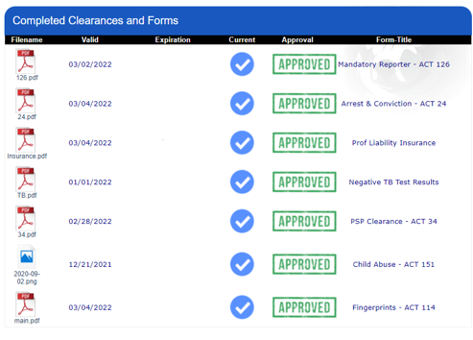
Process…
If you have never submitted any clearances, this is what you will see under missing forms.
If you have submitted clearances in the past, this is what you will see under completed forms.

Slide 6

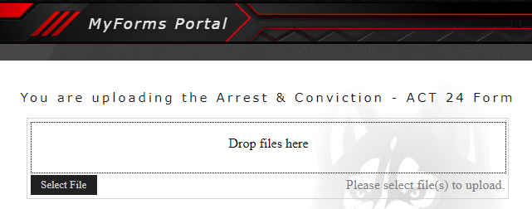
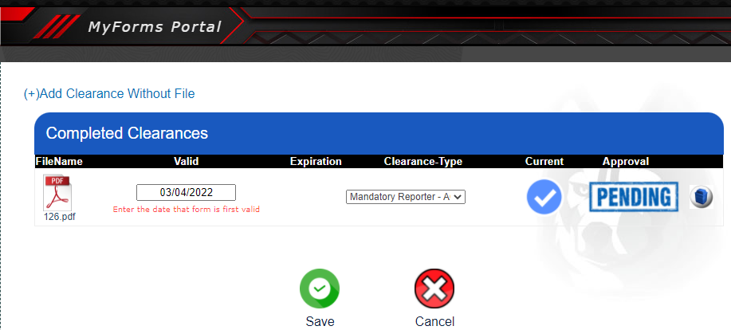
Process…
Each of these clearances has a clickable link.
Click on the name of the clearance you would like to submit.
Select or drag and drop your file.
Click ‘upload’ and enter the valid date shown on the clearance (not today’s date) and click save.
For the professional liability insurance, it will prompt you to enter a valid start and end date.
  On PSEA insurance, use the first day of the month of purchase and the last day of August of the year of expiration (i.e., 9/1/23 – 8/31/24).
  After you hit save, it will show as pending. At this time, if you need to revise something, you can:
    Replace the entire entry by hitting “replace”.
    Click the edit button to change or update any dates. Please be careful to enter the correct dates.
1
2
3

Slide 7

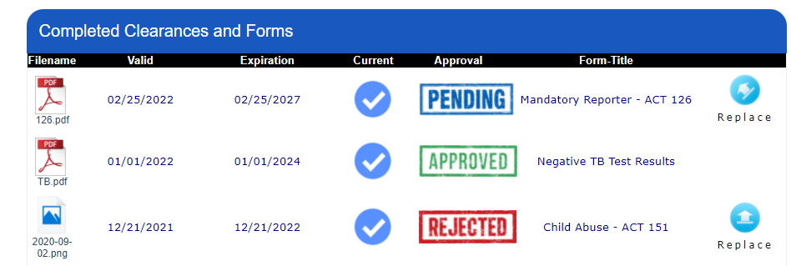
Process…
Once you hit save, you will see several approval statuses.
Approved – means it was reviewed and everything is in order.
Pending – means it is waiting to be approved (This can take 24-48 business hours to be reviewed.)
Rejected – means it has been reviewed and has been rejected.
This Photo by Unknown Author is licensed under CC BY-SA

Slide 8

What if my clearance is Rejected..?
If your clearance is rejected, you will receive an email with a brief explanation.
You will need to resubmit that clearance.
Hit the replace button, and you can re-upload the clearance for approval.
Make sure you click save when finished.

Slide 9
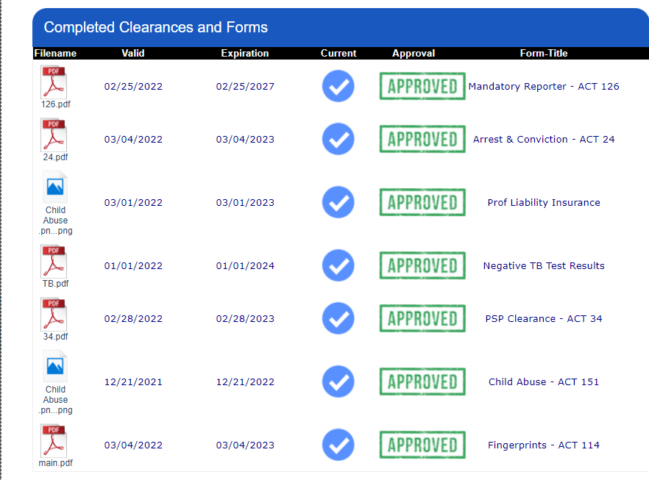
What if all my clearances are approved..?
Once all seven (7) of your clearances are listed as approved, you have completed the process. Congratulations!
It is always a good idea to keep a screenshot of approved clearances with you to show your professors.
You should always keep copies of your clearances with you when you participate in field experiences.

Slide 10
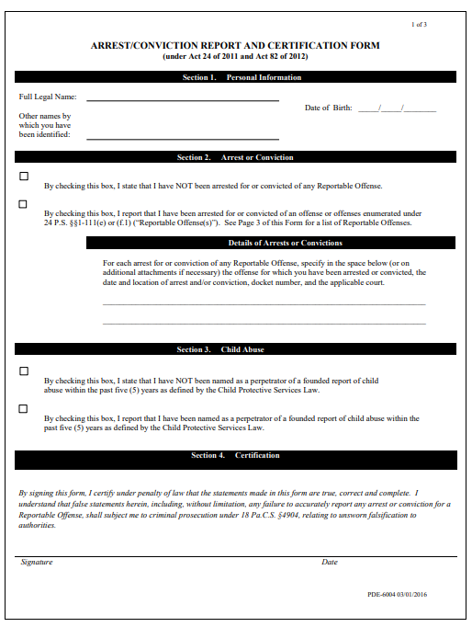
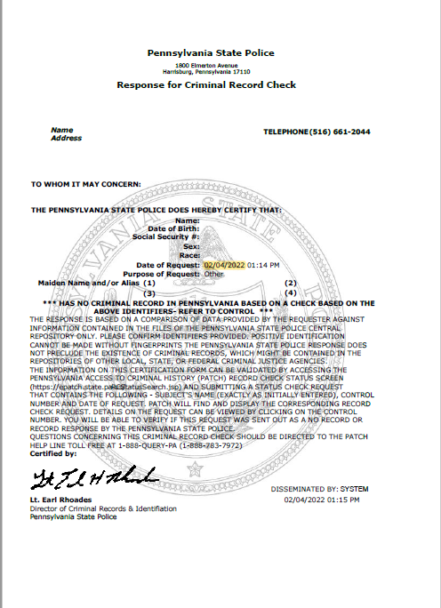
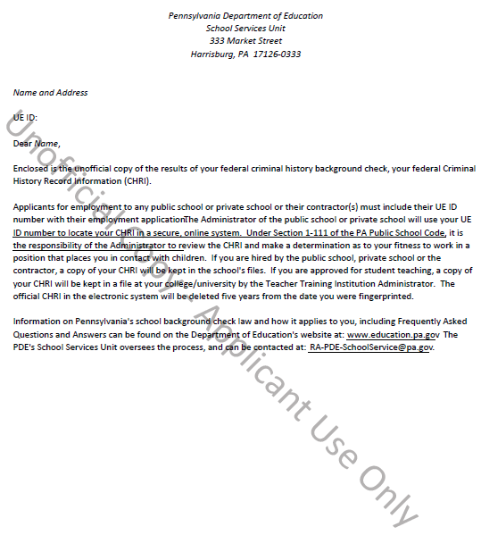
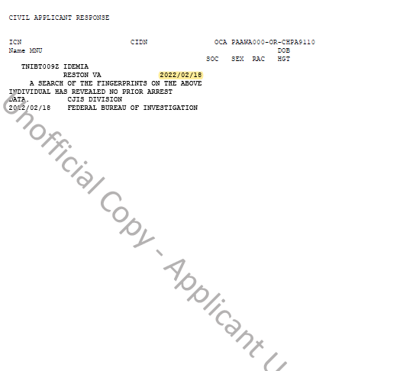
Clearance Examples
ACT 24
ACT 34
ACT 114
Page 1
EXAMPLES ONLY
Page 2

Slide 11
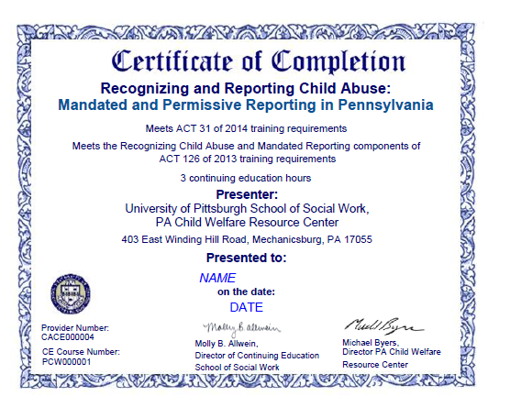
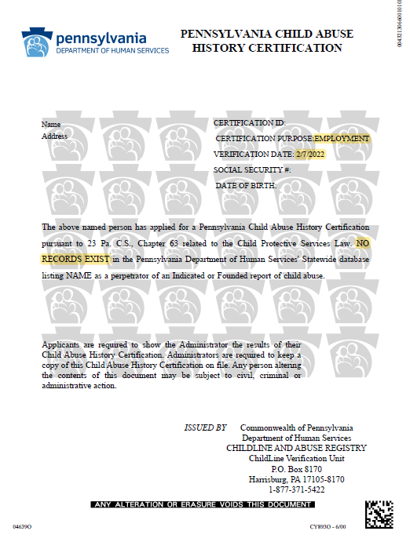
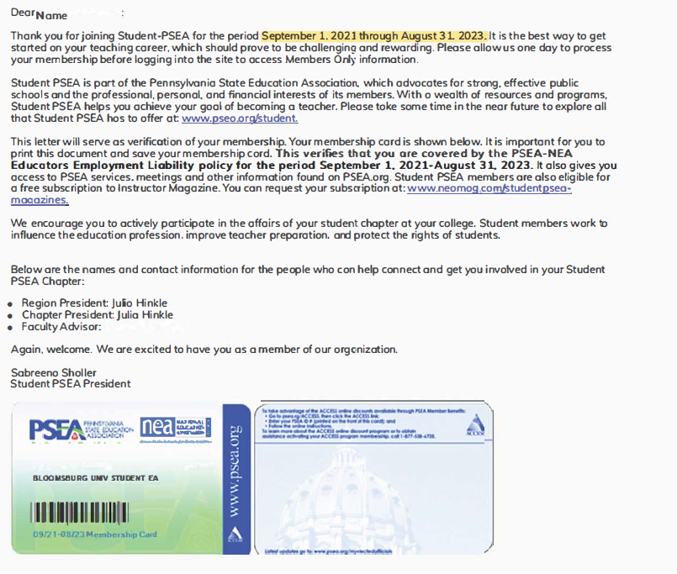
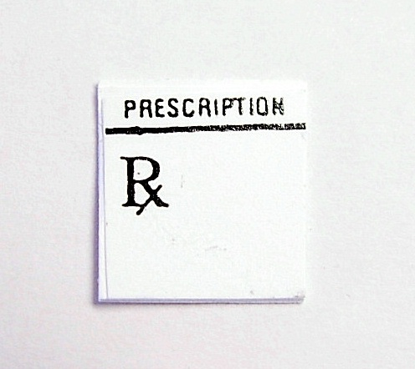
Clearance Examples
ACT 126
ACT 151
Insurance
Negative TB
Test Result
Proof of Negative TB test will vary based on location that you got it done. Must have name and dates on paperwork
EXAMPLES ONLY

Slide 12
Student Teaching
Clearances must be renewed prior to student teaching within specific dates:
Fall, 2024
No earlier than July 1, 2024 and no later than July 31, 2024.
Spring 2025
No earlier than November 1, 2024 and no later than November 30, 2024.

