Slide 1
Student Complaints and Concerns
August 8, 2023
Notes:
Welcome from Bashar

Slide 2
Introduction
Consider various types of student complaints and concerns (e.g., Title IX, sexual misconduct, harassment, discrimination, student conduct, academic issues, general complaints, safety)
Address federal, state, and MSCHE compliance and reporting requirements
Unify processes across campuses and develop automated forms through Maxient
Develop single access point on the CU Student Complaint and Concerns Web Page
Identify key points of contact likely to receive student complaints
Socialize basic approaches, resources, and practices
Address questions

Slide 3
Basic Process, Referral, and Resources
Solutions or Referrals
Utilize the referral function in CU-Succeed. Both the student and the office will receive a notification requesting outreach. This allows the University to track our supports and intervention in terms of student retention.
Determine whether your office can assist with a solution or if another office needs to be included.
If another office is to be included the best practice is to walk the student to that office and explain the situation to the staff receiving the students.
If an in-person walk over is not an option, a heads-up email to the receiving office should be sent detailing the concern/problem and how that office may assist the student.
In no case should a student be simply told to go to another office without information being sent to the other office. (see reporting – next slide)
Some issues may require multiple offices working together.

Slide 4
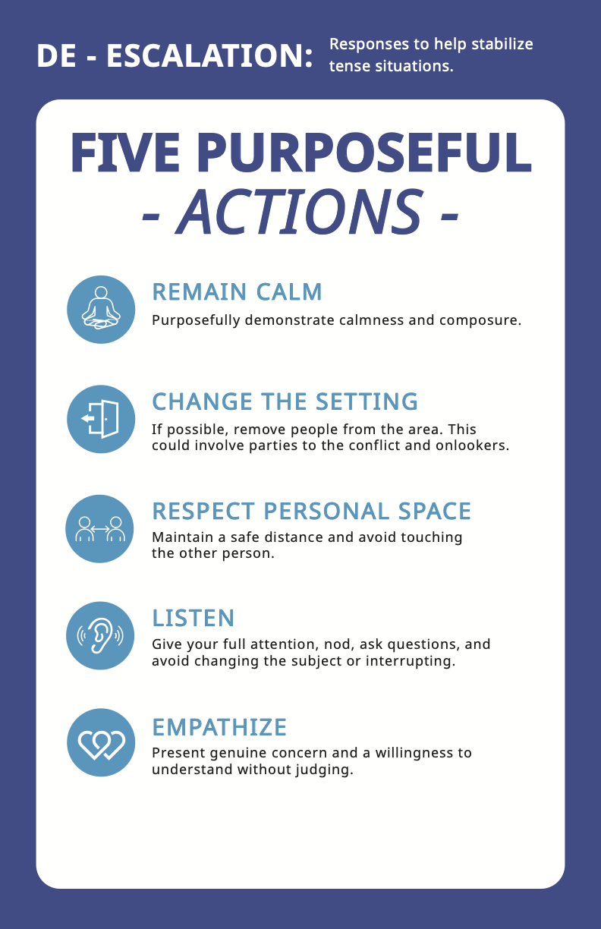
Basic Process, Referral, and Resources
Working with a student who has a concern/problem/grievance:
De-escalation (if needed)
Stay calm and keep your emotions in check.
Don’t take the student’s behavior personally or react defensively.
Acknowledge their feelings and what triggered their concerns.
Use I statements and reflective listening.
If the student’s behavior is too disruptive, dangerous, or persistent, you may need to refer them to another staff member or office for further support.

Slide 5
Basic Process, Referral, and Resources
Reporting
It is important to document any incidents involving students in your office. Write down the date, time, location, participants, description, and outcome of the event. If appropriate use the correct form to document students of concern, student conduct, sexual misconduct or other concerns/grievances.
Reach out to other offices like Student Conduct, Title IX, DEI or the Dean of Students Office for consultation.
Use factual and objective language and avoid making assumptions or judgments.
Share your observations, concerns, and actions taken with other staff who are involved. Listen to their feedback and suggestions and collaborate on finding solutions
Finally, you should review your own practices and strategies for dealing with upset students. Reflect on what worked well and what could be improved.

Slide 6
Academic Policies and Procedures
Vice Provost Office Monitors – Staff housed within the Office of the Vice Provost
These are tracked through Maxient – Our Student Conduct system
A compilation of Academic Policies and Procedures can be found at the following link. All of these complaints and concerns ensure due process for both the student and the faculty.
https://www.commonwealthu.edu/student-complaints-and-concerns
Most Commonly used:
Academic Grievance Procedures (PRP 3592)
Student grieving a grade and/or professional responsibility
https://cm.maxient.com/reportingform.php?BloomsburgUniv&layout_id=7
Academic Integrity (PRP 3512)
Faculty members should inform the student first and let them know that dishonesty has been suspected and steps will be taken.
https://cm.maxient.com/reportingform.php?BloomsburgUniv&layout_id=11

Slide 7
Student Complaints and Concerns
Students of Concern/CARE Team
If a student is experiencing difficulties including but not limited to:
Absences (family emergencies, medical needs, other urgent issues – not vacations)
Dealing with the impacts of medical or personal emergencies
Resource Insecurities
Mental Health/Behavioral concerns
Help connecting to resources both on campus or locally
Referrals from the campus community
Other Non-Emergency but concerning behaviors, concerns or issues
How to report:
Via the Student of Concern Form:
Bloomsburg: https://cm.maxient.com/reportingform.php?BloomsburgUniv&layout_id=3
Lock Haven: https://cm.maxient.com/reportingform.php?LockHavenUniv&layout_id=6
Mansfield: https://cm.maxient.com/reportingform.php?MansfieldUniv&layout_id=11
Phone: 570-389-4734
Email: deanofstudents@commonwealthu.edu

Slide 8
Student Complaints and Concerns
Students of Concern/CARE Team
What should I include in a report:
Who
The student of concern
Reporting party (this could be you or someone who has approached you)
Other witnesses or people involved or named in the report
What
What is the concern, behavior or problem that has occurred?
When
When did this begin, end? Is it on-going?
When were you made aware of it?
Where
Where did the concern occur? (if applicable)
Why
Why did problem or concern occur?
How
How did you become aware?

Slide 9
Student Complaints and Concerns
Student Government Matters and Feedback
Bloomsburg: https://www.bloomu.edu/contact-cga
Lock Haven/Mansfield: Contact Dean of Students Office
Student Non-Academic Grievance Procedures (PRP 4862)
https://www.bloomu.edu/prp-4862-student-non-academic-grievance-policy
https://cm.maxient.com/reportingform.php?BloomsburgUniv&layout_id=10

Slide 10
Student Complaints and Concerns
General Student Complaints
Informal Student Complaint Process
Students who wish to lodge a complaint about a faculty or staff member not covered by the procedures in the above-listed sections, academic catalogs, and/or student handbook are encouraged to address the complaint informally by:
Seeking to resolve the issue with the faculty or staff member directly; if there is not a satisfactory resolution then
Seeking to resolve the issue with the help of the department chair or the staff member's direct supervisor; if there is not a satisfactory resolution then
Seeking to resolve the issue (if academic) with the College Dean or Associate Dean, if there is not a satisfactory resolution then the Dean of Undergraduate Education or the Dean of Graduate Education can be contacted
Seeking advice from the Dean of the Students about how to resolve the issue (if non-academic) informally and, if warranted, information about the formal complaint process.
Formal Student Complaint Process
https://cm.maxient.com/reportingform.php?BloomsburgUniv&layout_id=8

Slide 11
Student Conduct
Role and History of Student Conduct
Rights and Responsibilities
Institutional and Individual
Student Code of Conduct
https://www.commonwealthu.edu/documents/cu-student-code-conduct
Referral pathways
Res. Life
University Police
Other reporting sources
https://www.commonwealthu.edu/student-complaints-and-concerns

Slide 12
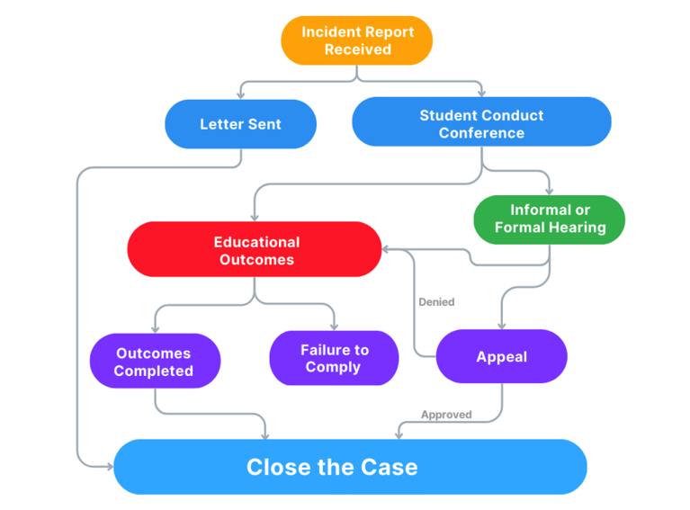
Student Conduct
What happens when a student is referred?

Slide 13
Student Conduct
Key takeaways:
OSC is tasked with facilitating a process – outcomes are not guaranteed.
In most cases, OSC will not/cannot share the outcome of a case with you.
Before you refer a student to the Office of Student Conduct
Talk with the student about their behavior
Document alleged incidents and your conversations
Share your documentation with the Office of Student Conduct
Contact us at any time for a consultation – there may be other PRPs that address a specific behavior.
Hazing
Refer to Office of Student Conduct

Slide 14
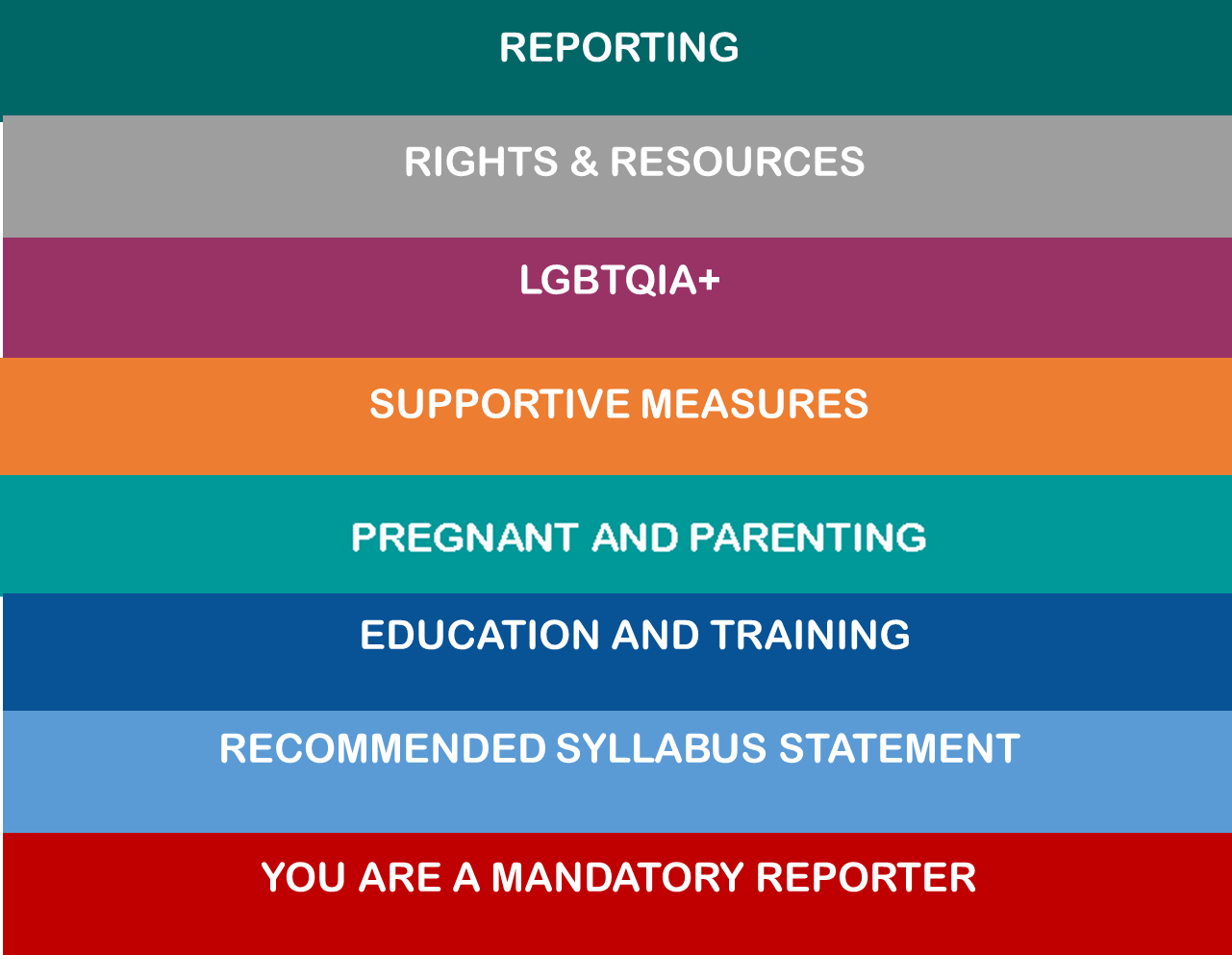
Sexual Misconduct and Title IX
Informational Resources
Mandatory Reporters
Reporting
CU TIX Webpage: commonwealthu.edu/title-ix
Email or call!
Process
Advanced Training

Slide 15
Americans with Disabilities (PRP 2060)
Policy Overview
An individual with a disability is defined by the ADA as a person who has a physical or mental impairment that substantially limits one or more major life activities, a person who has a history or record of such an impairment, or a person who is perceived by others as having such an impairment.
In accordance with the Americans with Disabilities Act of 1990, as amended, and the Rehabilitation Act of 1973, Commonwealth University will make every reasonable effort to provide equality of opportunity and freedom from discrimination for all members of the University community and visitors to the campus locations, regardless of any disability an individual may have.
Accordingly, Commonwealth University has taken positive steps to make campus facilities accessible to individuals with disabilities and has established procedures to provide reasonable accommodations to allow individuals with disabilities to participate in and/all University programs.
Commonwealth University is committed to the goal of fairly balancing the provision of reasonable accommodations with the academic integrity and rigor demanded of institutions of higher learning.

Slide 16
Americans with Disabilities (PRP 2060)
How to Request Accommodations: Students and Employees
Students
To request an accommodation in the CU learning environment, students with a disability must submit appropriate documentation and meet with a staff member in CU Disability Services to discuss the needs and requested accommodation(s).
University Disability Services - Warren Student Services Center, #043; 570-389-4265 or 570-389-5205
Employees
To request an accommodation in the CU workplace, employees with a disability must contact the ADA Coordinator. Documentation from a professional provider (e.g. psychologist, psychiatrist, or medical provider) is required. This documentation must identify the employee’s diagnosis, including how the diagnosis limits major life activities, and indicate if the employee is able to perform essential job functions in the employee’s current position with or without accommodation(s), as well as the recommended accommodation(s) based on the diagnosis.
ADA Coordinator - Ms. Tesse Fosse; 570-389-5529

Slide 17
Harassment and Discrimination (PRP 4789)
It is the responsibility of each person on campus to respect the personal dignity of others and to demonstrate a basic spirit that precludes unlawful harassment and discrimination.
Commonwealth University has established this policy to promote an educational and work environment that is free from all forms of harassment and discrimination, whether because of race, color, religion, sex, sexual orientation, gender identity, age, national origin, ancestry, disability, or veteran status or any other characteristic protected by law.
Commonwealth University is committed to freedom of thought, discourse, and speech and the attainment of the highest quality of educational and academic pursuits. Nothing in this policy is meant to infringe upon the First Amendment or other constitutional rights of any individual.

Slide 18
Harassment and Discrimination (PRP 4789)
Where to File Your Complaint
Complaints against: University students
File complaint at: The Dean of Students Office
Complaints against: Faculty members
File complaint at: Academic Affairs (Provost/Dean) and/or Office of Diversity Equity and Inclusion
Complaints against: Non-Faculty University employee
File complaint at: Human Resources and/or Office of Diversity Equity and Inclusion
Complaints against: An individual from Office of Diversity Equity and Inclusion
File complaint at: Human Resources

Slide 19
Commonwealth University Inclusive Community Concern Report
Commonwealth University holds that an inclusive community is a core value that is an essential part of the foundation for our community. We affirm our shared values, recognize our challenges, and commit to building on existing efforts to foster a diverse, equitable, and inclusive campus community.
Together, using a social justice framework, we will be actively engaged in the creation of an environment that is characterized by a commitment to inclusive excellence. We know that to create an inclusive campus community, it will take individual and collective action to challenge and respond to bias, harassment, discrimination, and oppression.

Slide 20
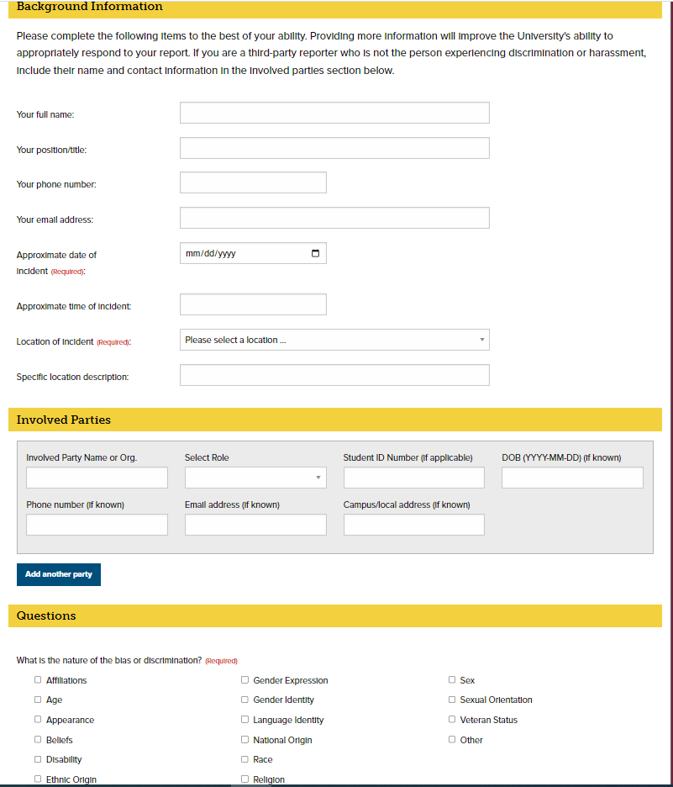
Commonwealth University Inclusive Community Concern Report

Slide 21
Safety, Security & Police
Scenarios when it is appropriate to reach out to University Police – Director Leo Sokoloski
Urgent vs. Emergency (ex. life – safety, off campus matters, mental health, serious injuries – death of a student)
Contacts for each campus Chief of Police (Welkom, Perry, Coxford)
Police follow a paramilitary chain of command. A complaint regarding police personnel shall be directed to the Chief of Police.
A complaint surrounding a parking ticket, arrest, traffic or non-traffic citation should be directed to Director Sokoloski. (Criminal Justice information is protected and cannot normally be shared)

Slide 22
Questions and Answers

