Slide 1
General Education Program Deep Dive Assessment FYS — Oral Communication — Quantitative Reasoning — Writing April 22, 2025

Slide 2
Agenda
GE Deep Dive Assessment Goals
Area Reports: FYS, OC, QR, WC
Questions and Discussion
GEC Assessment Summary & Next Steps

Slide 3
Deep Dive Schedule
Year | Semesters of Data Collection | Program Learning Goal | Academic Year Review
Year 1 | Fall 2023 – Spring 2024 | First-year Seminar | 2024-25
 |  | Writing
 |  | Oral Communication
 |  | Quantitative Reasoning
Year 2 | Fall 2023 – Spring 2025 | Historical Themes | 2025-26
 |  | Diversity
 |  | Global Perspectives
 |  | Foreign Language
Year 3 | Fall 2023 – Spring 2026 | Citizenship and Society | 2026-27
 |  | Ethical Reasoning
 |  | Critical Analysis and Reasoning
 |  | Natural World
 |  | Technology
Year 4 | Fall 2023 – Spring 2027 | Literature | 2027-28
 |  | Arts
 |  | Creative
Year 5 | Fall 2023 – Spring 2027 | Five-year program review | 2028-29

Slide 4
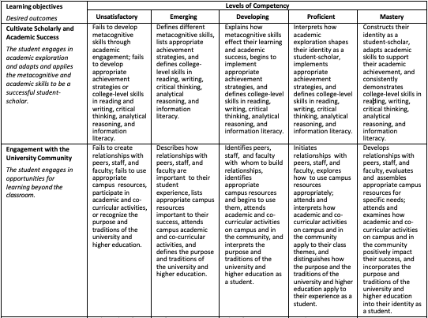
GE Deep Dive Assessment Goals
Identify effective assessment strategies & pedagogical approaches for student success
Evaluate learning outcome’s levels of competency & expected student competency
Identify any issues/concerns in the program area
Identify methods or practices for improving the GE assessment process

Slide 5
First Year Seminar Report
Group Members:
Denise Chaytor-Zugarek, Trio SSS Holly Jackson, Library Services
Ashley Lesniak, Rehabilitation Sciences Rebecca Willoughby, Student Succes
Takeaway Points
Assessment Methods: Essays, reports, written reflections, and projects
Difficult to assess in measurable ways given language of SLOs (e.g., promoting understanding, fostering development, engagement with community, cultivating growth)
Simplify assessment by reducing the number of “levels of competency” categories
Alter verbiage of SLOs and assess with a common final exam
General lack of reporting for semesters reviewed
Course cap increases will negatively impact assessments and process

Slide 6
Oral Communication Report
Group Members:
Angela La Valley and Paula Hopeck Communication Studies, Media, & Journalism
Takeaway Points
Assessments: Oral presentations, written reports (including analysis papers and speech preparation outlines), written reflections
Assessments are appropriate to the learning outcomes
Recommendation: add oral presentations as a distinct category of assessment

Slide 7
Oral Communication Report
Takeaway Points
Overall percentages of students rated proficient/mastery range from 56-79%
In general, fewer students achieve proficient/mastery in Supporting Materials
Students in asynchronous DE courses perform better than F2F students; F2F students have lower achievement on Delivery
Performance in spring semester is lower compared to fall semesters
Unique roles of Communication Apprehension & Course Level
Recommendation: consider setting competency benchmark at Developing and/or reduce levels of evaluation
Recommendation: additional focus on and practice with Supporting Material and Delivery in courses would be prudent
Recommendation: Continue to examine semester variance and modality trends

Slide 8
Quantitative Reasoning Report
Group Members:
Arian Moghadam, Business, Innovation & Technology
Cathy D’Ortona & Steve Williams, Mathematics, Computer Science, & Digital Forensics
Takeaway Points
Assessment Methods and Strategies: Current methods balance faculty resources and institutional changes while maintaining assessment integrity.
Recommendations
Maintaining existing methods to balance effectiveness and feasibility,
Sharing response examples - i.e., faculty actions and recommendation, to improve participation

Slide 9
Writing Report
Group Members:
Heather Erb, History, Philosophy, & Political Science
Jimmy Guignard, David Russell, Cassandra Sachar Languages, Literatures, & Writing
Takeaway Points
Pedagogical approaches to lead to more successful achievement of SLOs
Number of categories
Achievement expectations
Modalities
Data collection concerns

Slide 10
Questions & Discussion

Slide 11
GEC Assessment Considerations
Revise the number of ‘levels of competency’
Assist program areas with standardization of evaluations
Conduct training by program Area to promote resource/strategy sharing
Increase communication for deadlines, reported findings, use of data…
Promote practical tips to aid faculty collection and submission of data, (e.g., syllabus development, Brightspace strategies).
Next Step: Evaluate additional recommendations from Deep Dive process

